Slide 1
Input/Output
Muhammad HabibUllah
habib.wattoo@nu.edu.pk

Slide 2
Book Chapter
“Computer Organization and Architecture”
Author “William Stallings”
8th Edition
Chapter 7
Section 7.1
Section 7.2

Slide 3
I/O Problems and Module
Wide variety of peripherals
Delivering different amounts of data
At different speeds
In different formats
All slower than CPU
Need I/O Modules to interact with CPU and Memory
Interface to CPU and Memory
Interface to one or more peripherals

Slide 4
Generic Model of I/O Module
Address Lines
Data Lines
System Bus
Control Lines
I/O Module
Links to
Peripheral
Devices

Slide 5
External Devices
Human-readable
Screen, Printer, Keyboard
Machine-readable
Monitoring and control
Magnetic disks and Tape drives
Communication
Modem
Network Interface Card (NIC)

Slide 6
External Devices Block Diagram
Control Signals from I/O Module
Status Signals to I/O Module
Data bits to and from I/O Module
Control Logic
Buffer
Transducer
Data (Device-unique) to and from environment

Slide 7
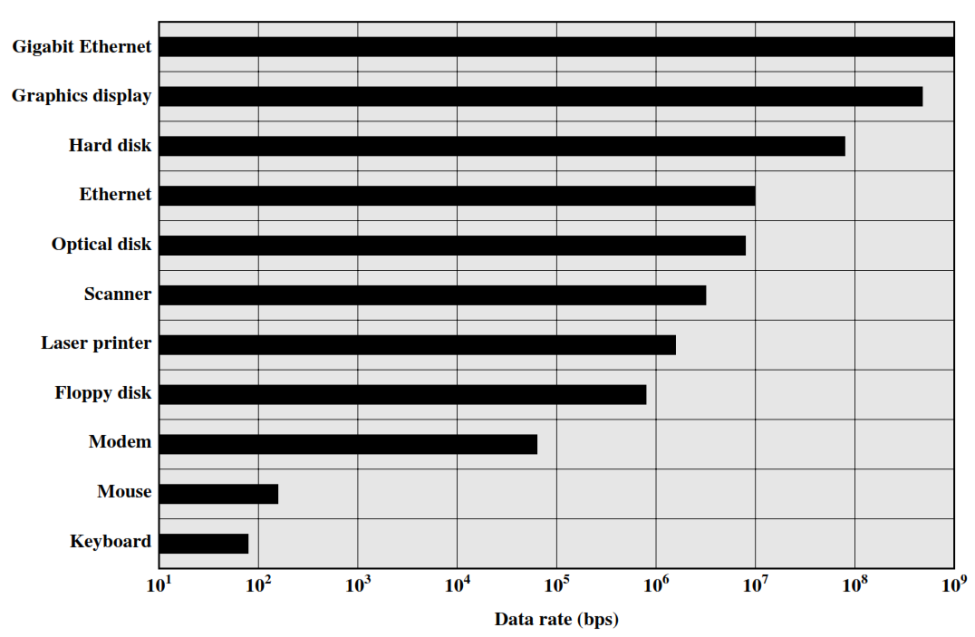
Typical I/O Device Data Rates

Slide 8
I/O Module Function
Control and timing
To coordinate the flow of traffic between internal resources and external devices
Processor communication
Communication between processor and I/O module
Device communication
Communication between device and I/O module
Data buffering
Necessary because of different data rates of processor and peripheral
Error detection
Unintentional changes to the bit pattern are detected

Slide 9
I/O Steps
CPU checks the status of peripheral by I/O module
I/O module returns status of external device
If ready, CPU requests the data transfer
I/O module obtains a unit of data from external device
Data are transferred from I/O module to the processor

Slide 10
Block Diagram of an I/O Module
Interface to system bus
Interface to external device
Data Registers
External device interface logic
Data
Status
Data lines
Control
Status/Control Registers
Address lines
I/O Logic
External device interface logic
Data
Status
Control lines
Control

